Slide 1

Real Estate House Price Prediction Website
Hayley , Catherine , Nasrin , franco

Slide 2

Problem Statement
CATHERINE
House prices in Melbourne has gone crazy over time. We would like to understand the relationship between different house features and how they are used to predict house price.
This is intended for home buyer / seller / real estate agent use.

Slide 3

Requirements
CATHERINE
Operating environment
Language - Python / JavaScript / HTML / CSS3
Server - Python / Flask
Visualisation - Tableau
User - Web Browser

Slide 4

Hypothesis
CATHERINE
The analysis is based on the factors that could potentially affect the house price:
Hypothesis 1 - The distance from CBD has positive correlation to house prices regardless of the region.
Hypothesis 2 – The more nearby schools in the neighbourhood, the more expensive is the house prices.
Hypothesis 3 - The higher the crime rate, the lower the house prices.
Hypothesis 4 - No of Rooms , Bathrooms , Car park have direct impact on the house prices.

Slide 5

Application & Demo
CATHERINE
We used python and flask to build the website and test the results. We created a JSON map of features and values to allow user to choose the input. Once they make the request, the application will receive and return a response containing the predicted price.

Slide 6

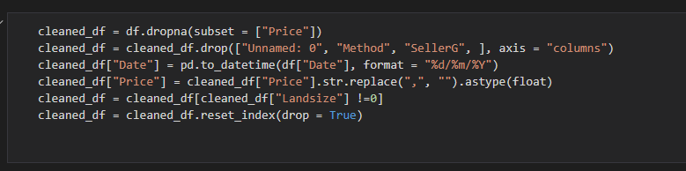
Data Cleaning
NASRIN
For the model to learn and train properly, we cleaned the data to ensure that all 0 and Nan are removed from the dataset.
Next, some columns were formatted to the proper sign to avoid any error.
Also removed some rows that has the 0 value as we deemed those info as inaccurate.

Slide 7


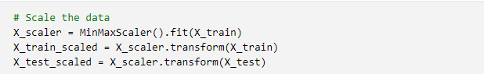
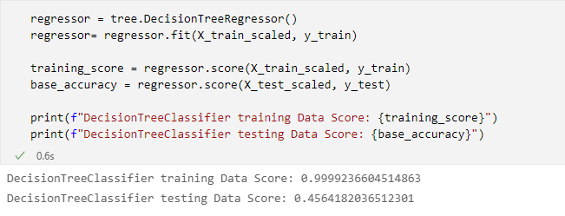
Machine Learning : Decision Tree
NASRIN

Slide 8
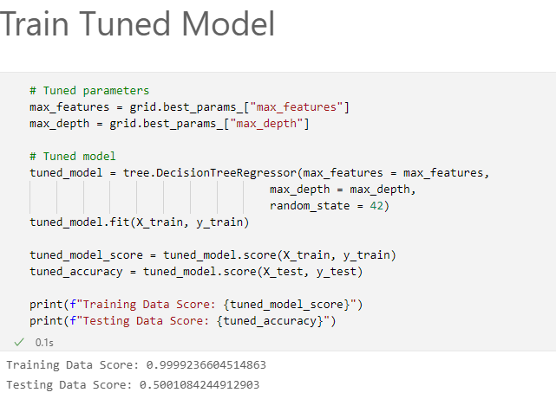
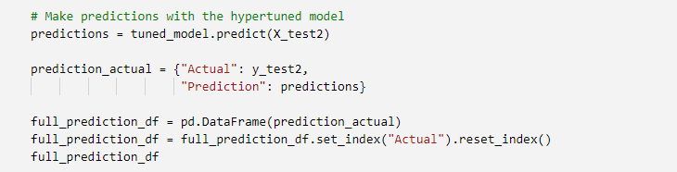
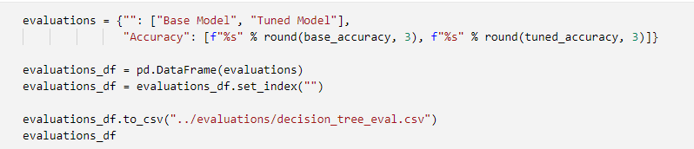
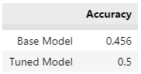
NASRIN

Slide 9

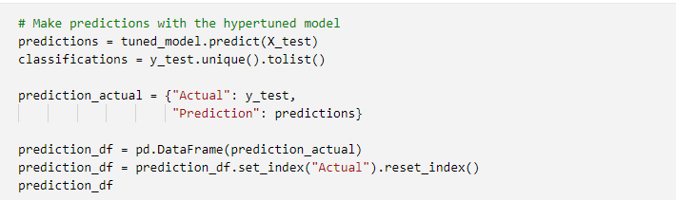
Machine Learning : Logistic Regression
NASRIN
1. Select the features
2. Split the data into training set, scale the data and train the model using logistic regression
3. Use the GridSearchCV to tune the model’s parameter.
3. Train tuned Model and make prediction

Slide 10
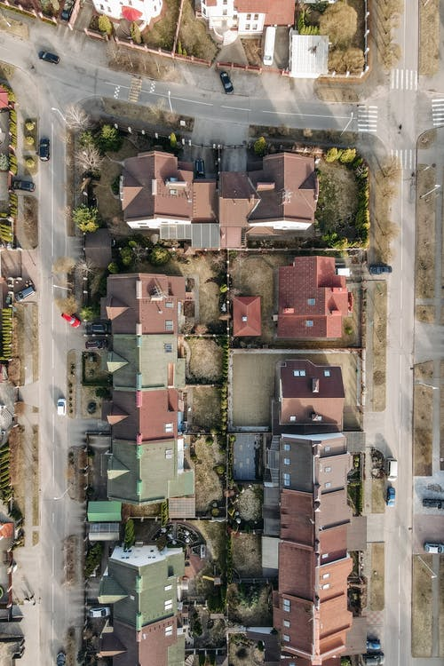
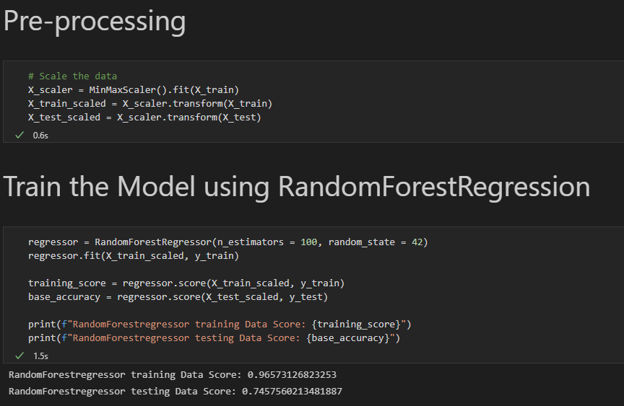
Machine Learning : Random Forest
FRANCO

Slide 11
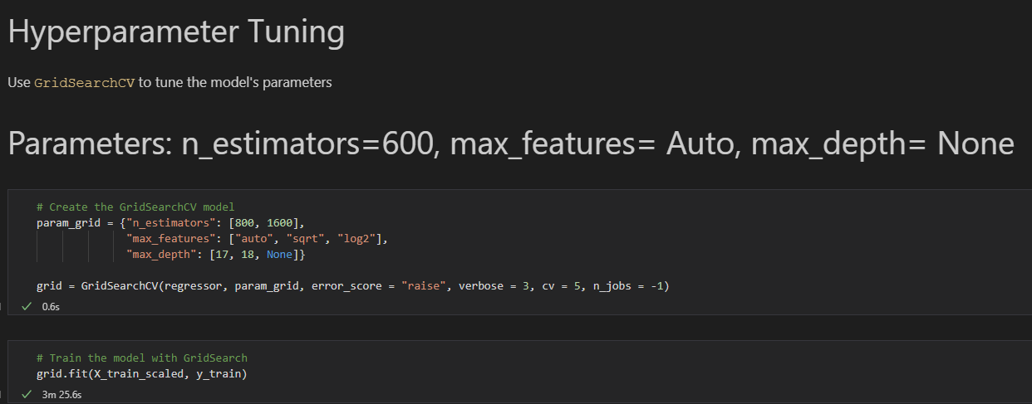
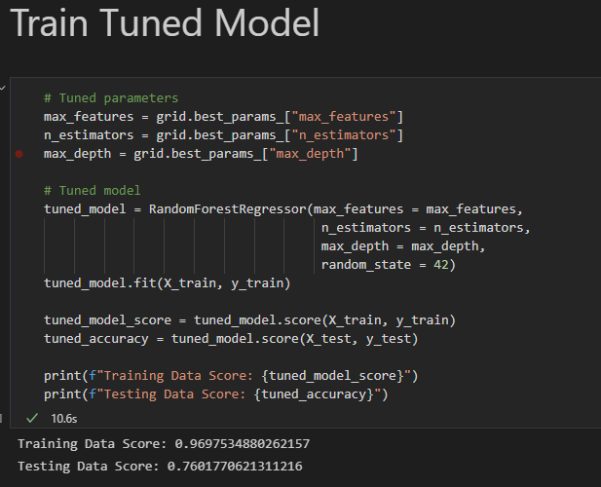
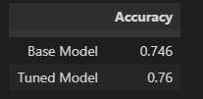
FRANCO

Slide 12

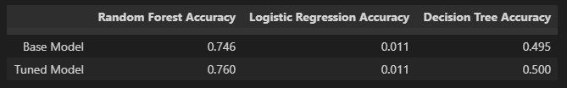
Model Comparison
FRANCO
Reason why we choose this?
What brings you to this decision?

Slide 13
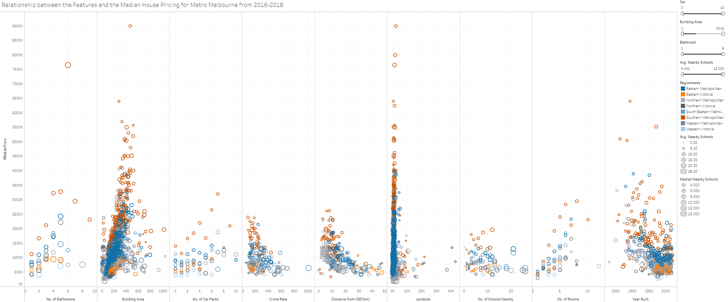
Data Visualisation
HAYLEY

Slide 14
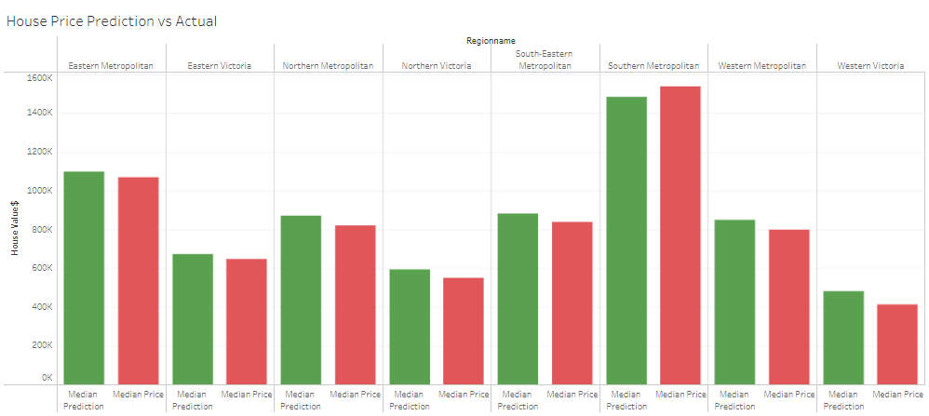
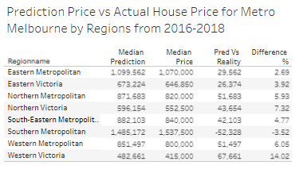
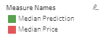
Prediction vs Actual
HAYLEY
https://public.tableau.com/authoring/FinalProject_16428453496070/Analysis#1

Slide 15
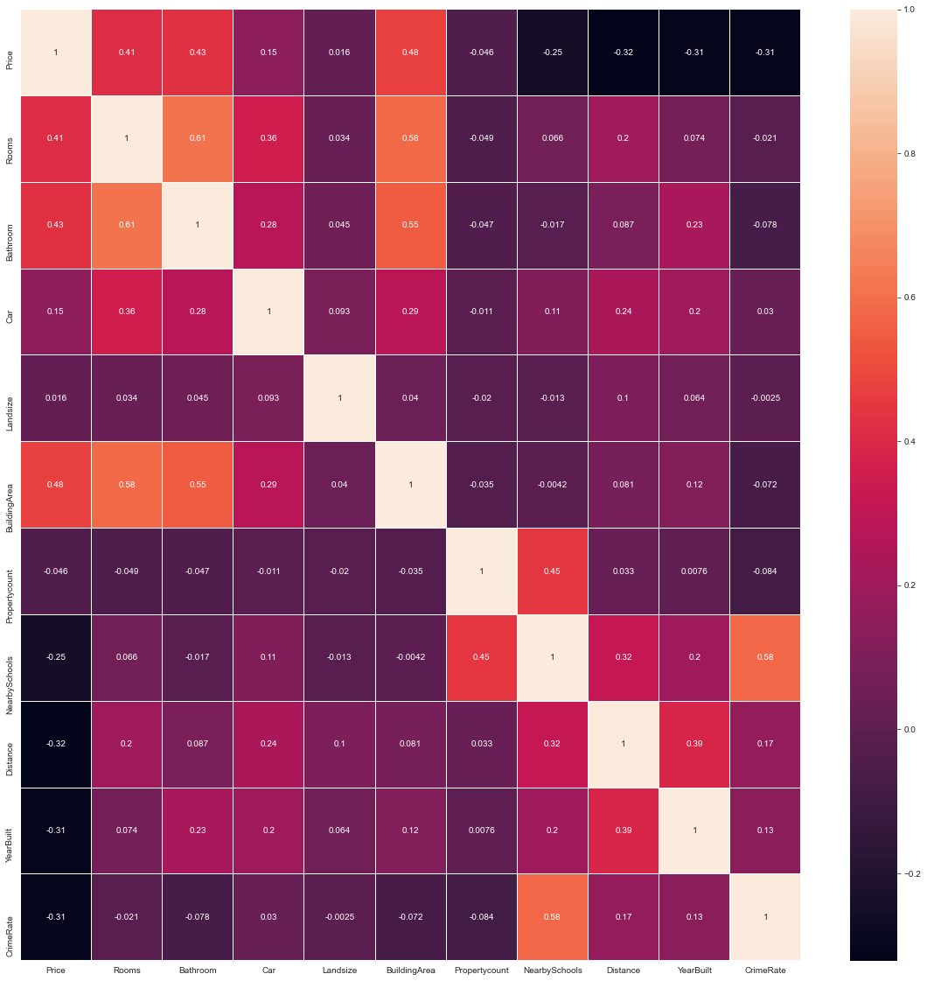
Observation from ML algorithm
HAYLEY
Before we apply the algorithm, our hypothesis were focusing on The distance from CBD , nearby schools , crime rate, No of Rooms , Bathrooms , Car park .
Now, our findings conclude the main factors that have positive relationship:
No of rooms
No of bathrooms
No of car park
Land size
Building area

Slide 16
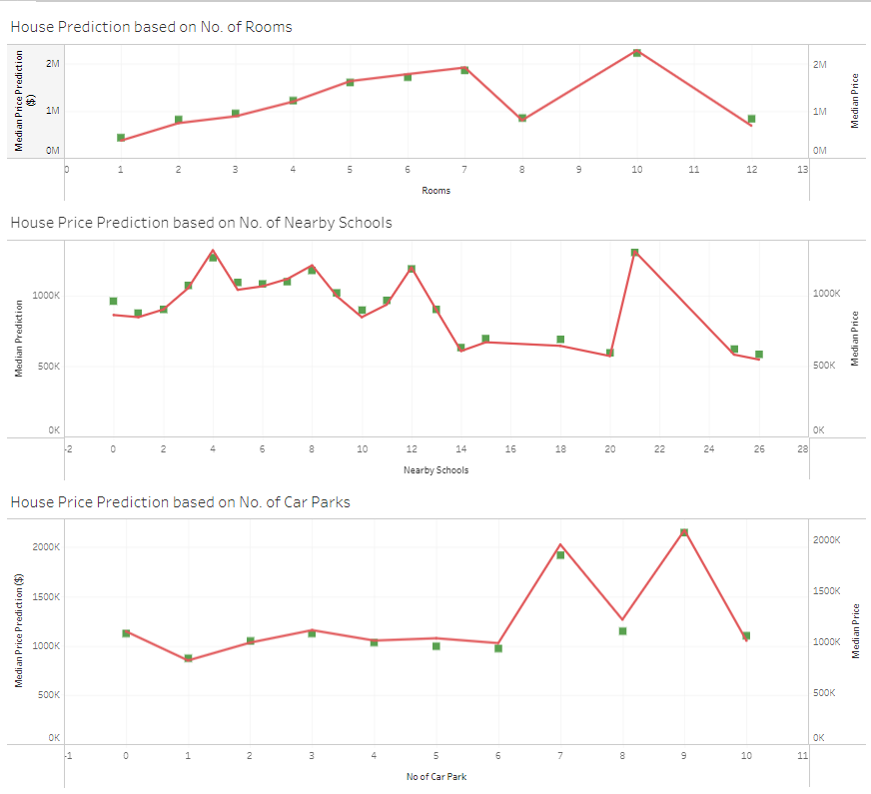
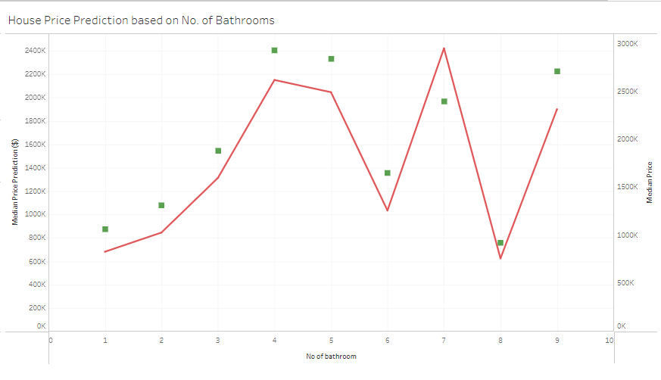
Prediction vs Actual
HAYLEY
https://public.tableau.com/authoring/FinalProject_16428453496070/Analysis#1

Slide 17

Findings & Summary
HAYLEY
Based on the algorithm, Nearby Schools / Distance from CBD / Year Built / Crime Rate has insignificant impacts on the house prices – proves our first three hypothesis wrong.
So far, the prediction is very close to the actual results, except in bathroom features.
Our limitation is the limited access to public data on house prices. As this info is very sensitive and industry-focused, we simply cannot obtain any data for free. Large datasets with too many columns can also hinder us from getting higher accuracy in testing result.

Slide 18

Conclusion (CATHERINE)
CATHERINE
House Prices are growing crazily regardless of the era we are in, as fluctuation happens over time. Through this we have tried to identify the factors that are less significant. We have used the machine learning to solve this real-world problem. This solution can be tested if we have most updated data to make a better prediction.

